Slide 1
Web U
Golpar Jalali

Slide 2
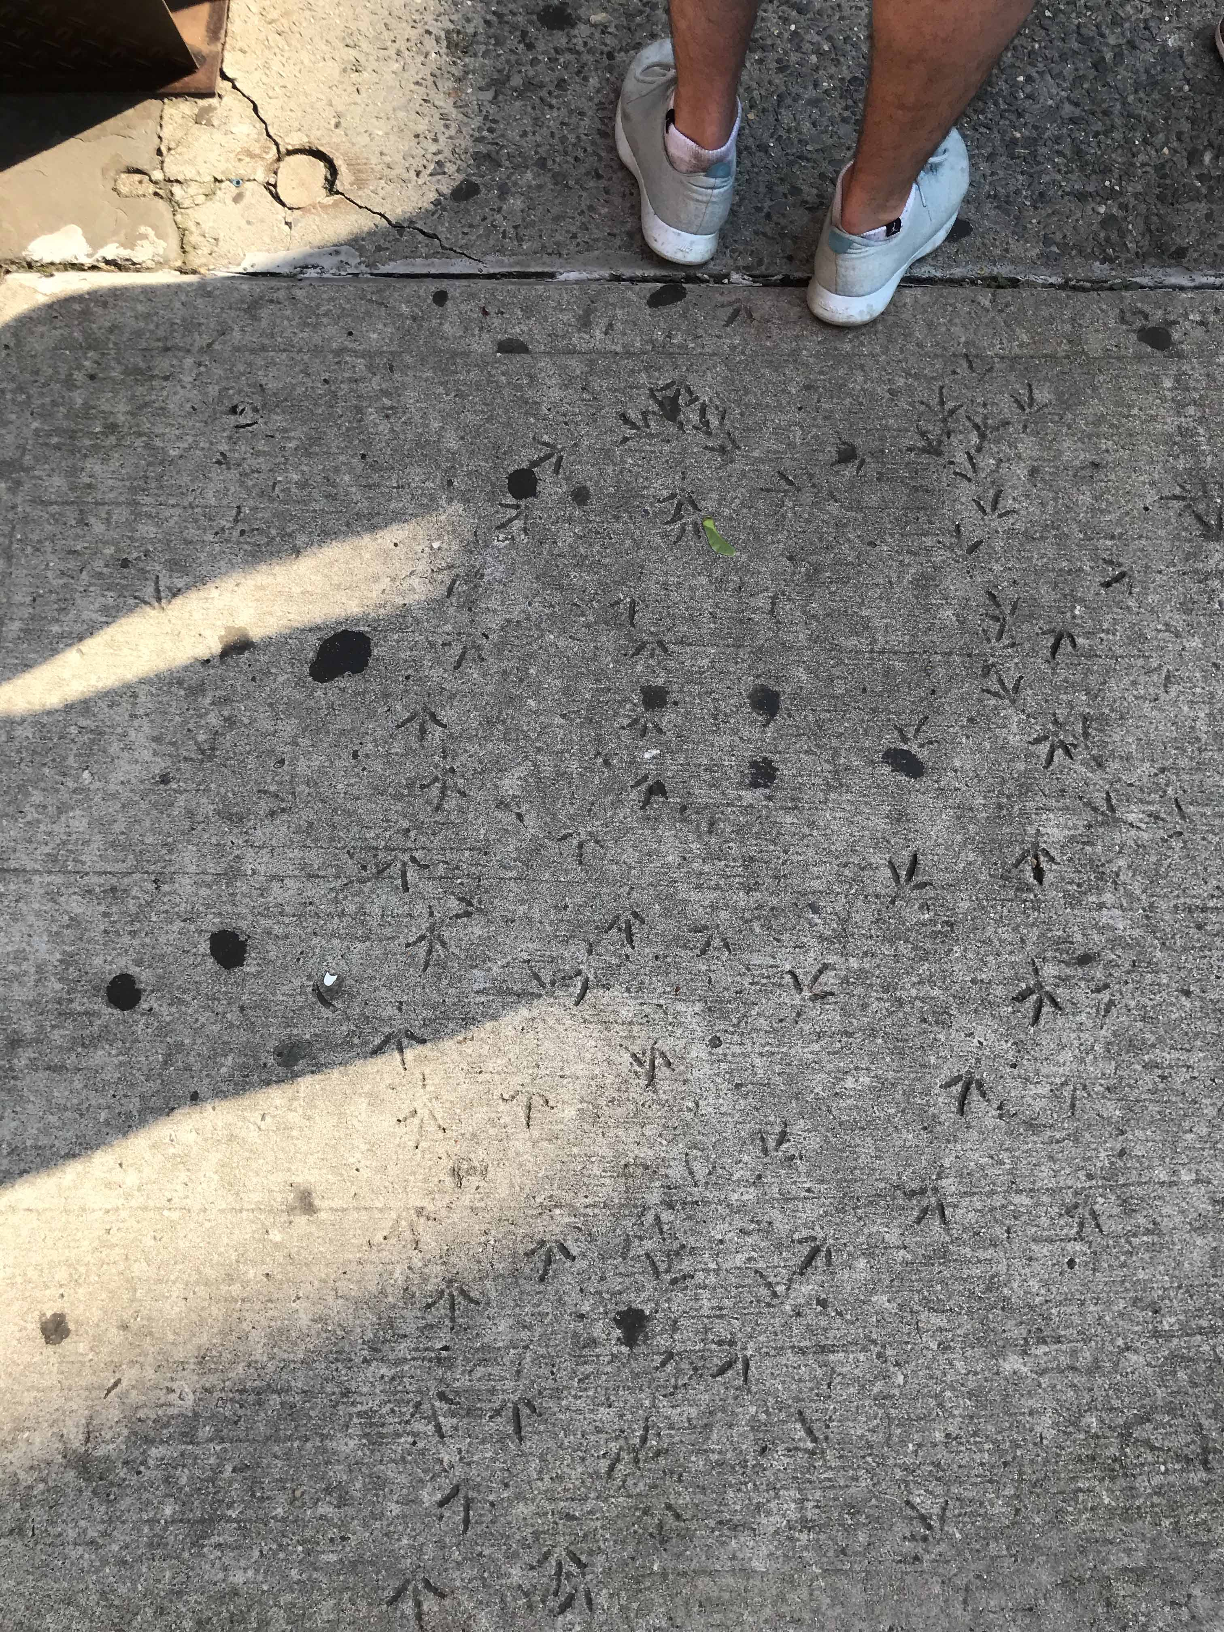
Allbirds

Slide 3
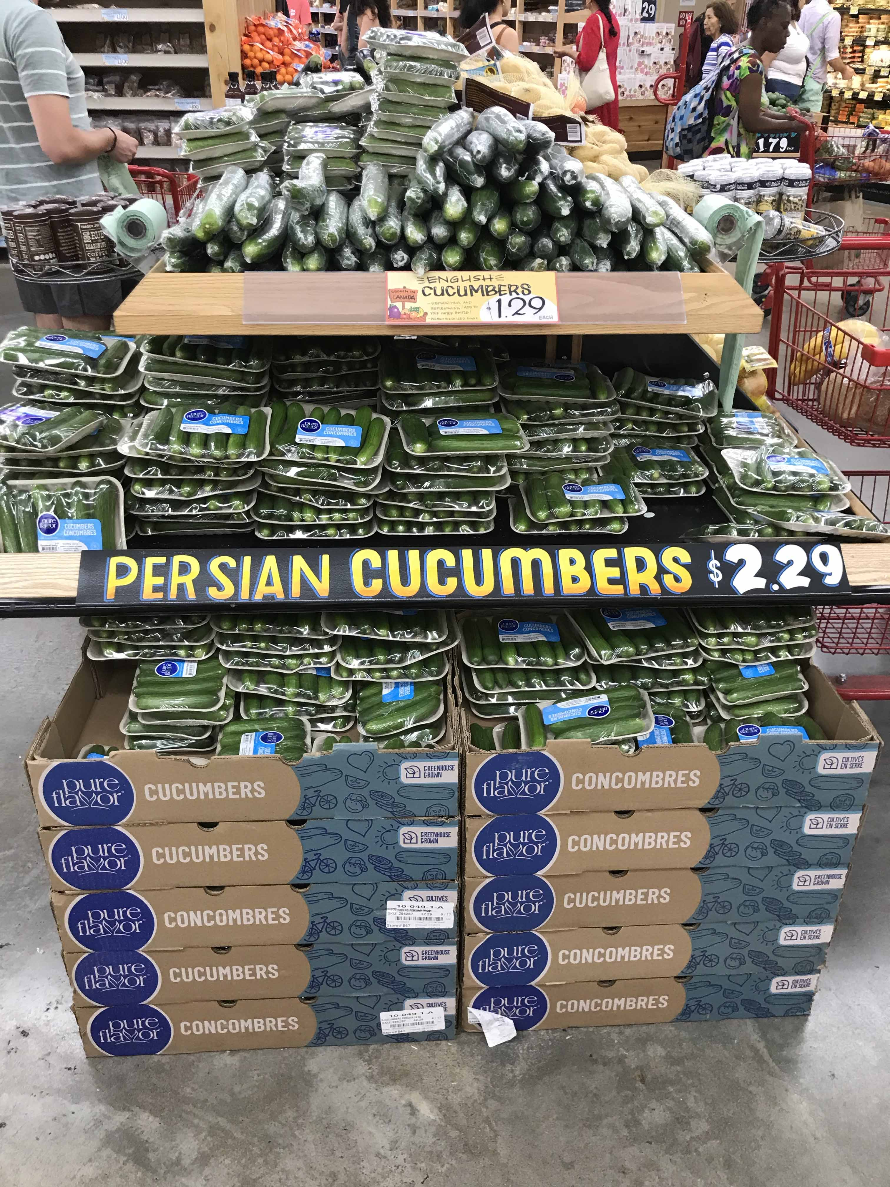
Had no idea this exist

Slide 4
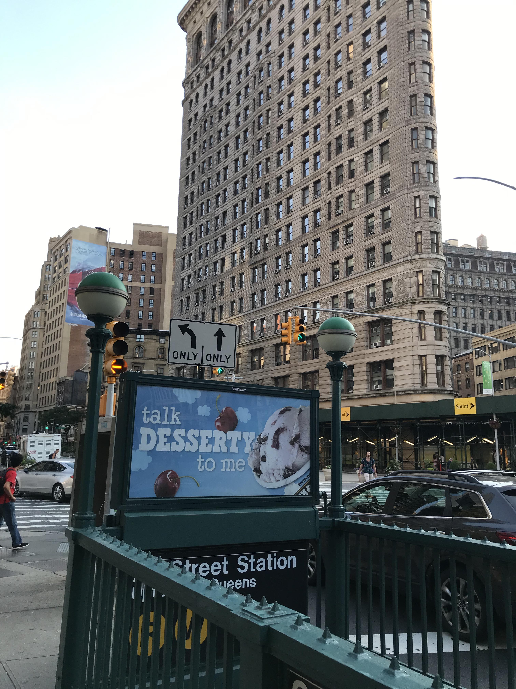
The background image is unattractive.
Cool slogan!

Slide 5


Slide 6
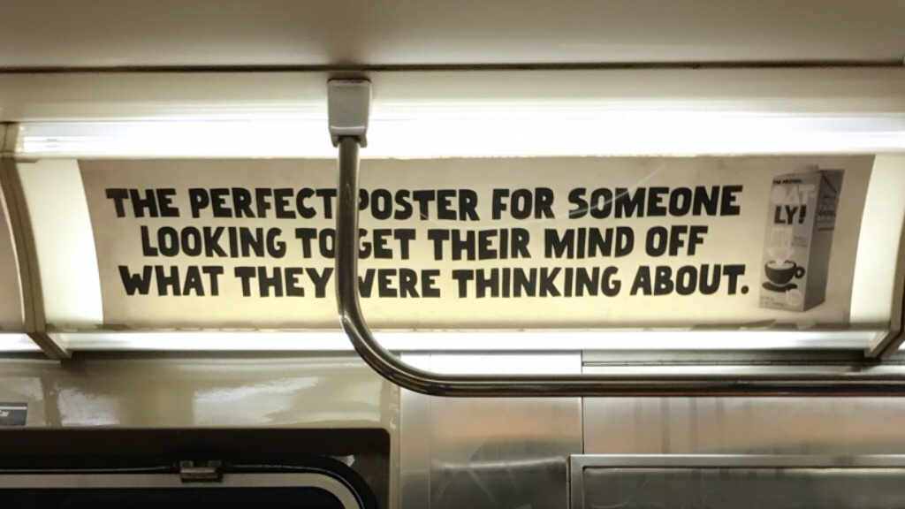

Slide 7
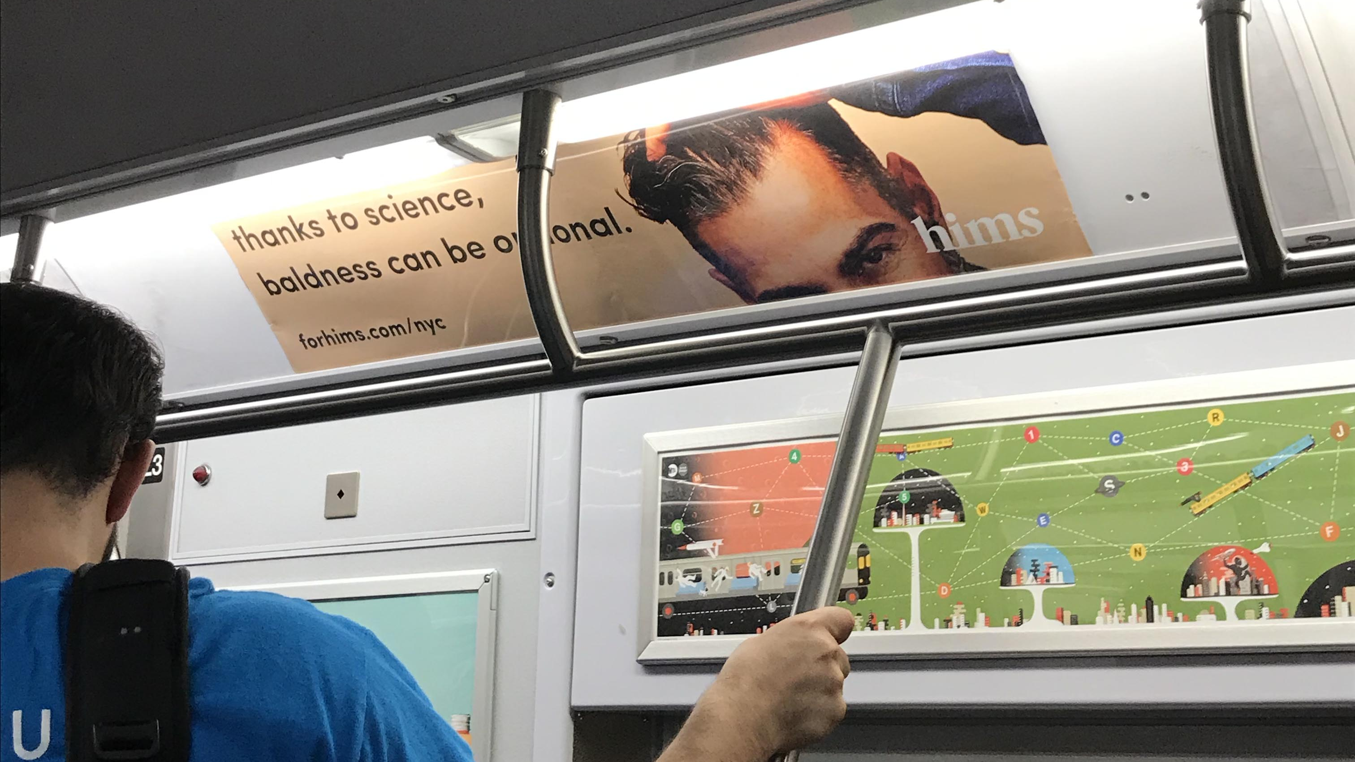

Slide 8
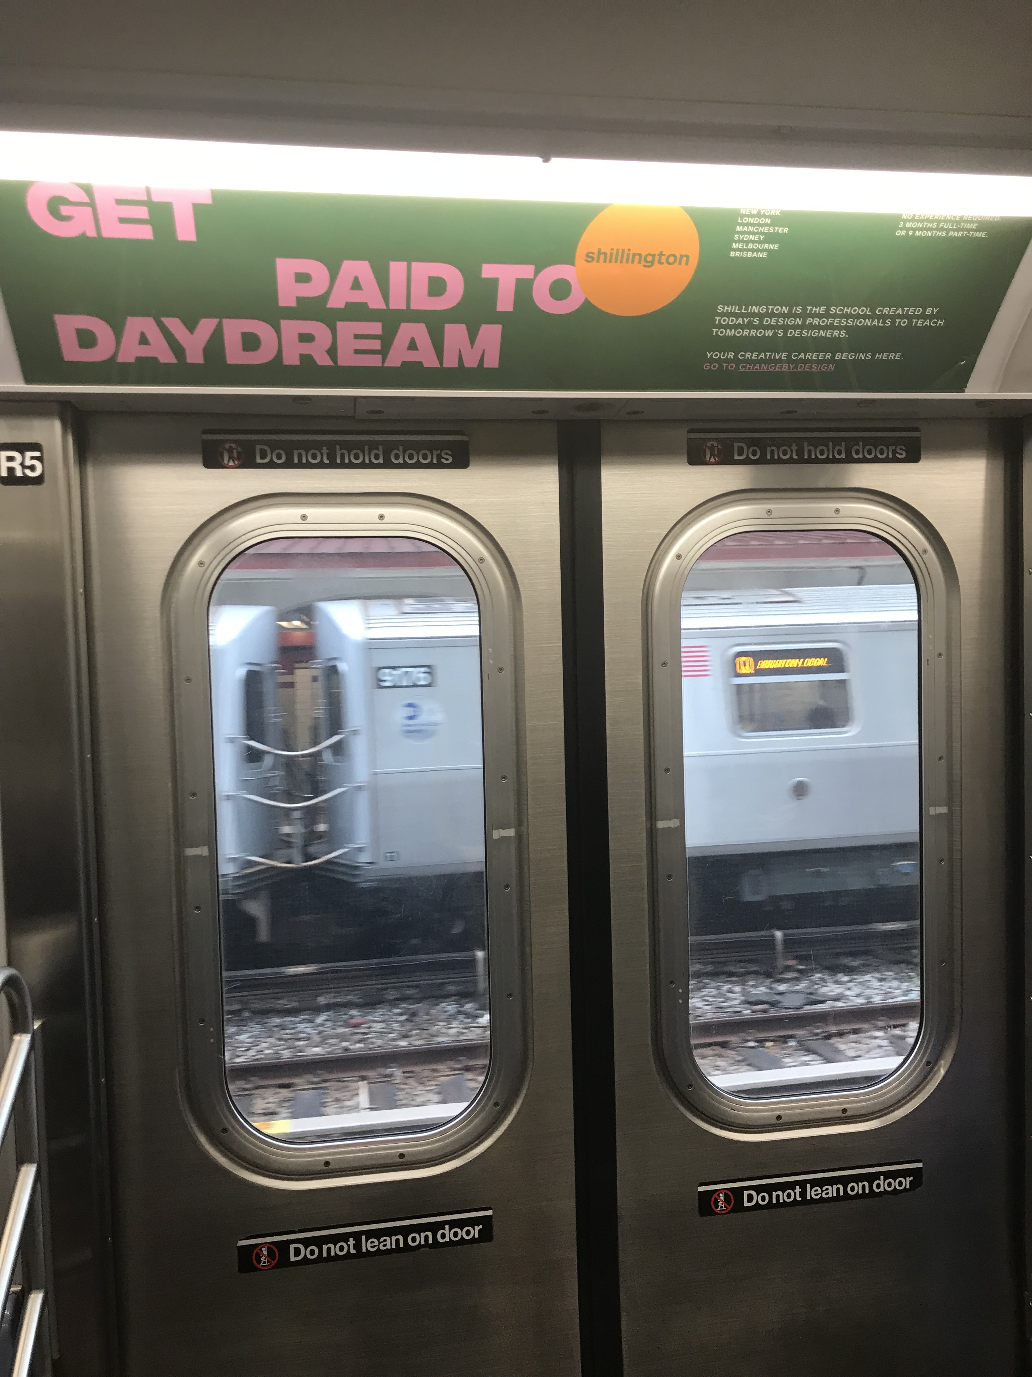

Slide 9


Slide 10
